Slide 1


Slide 2
Transformer Anatomy
References:
https://arxiv.org/abs/1706.03762
https://jalammar.github.io/illustrated-transformer/
https://towardsdatascience.com/transformer-neural-network-step-by-step-breakdown-of-the-beast-b3e096dc857f
https://www.youtube.com/watch?v=BK9C98J-JHw

Slide 3
Content
NLP Task
RNN model
Encoder-Decoder
Attention Mechanism
Transformer
Implement Transformer

Slide 4
NLP Task - Sentiment Analysis
Negative
Movie Reviews
“This has been a terrible film of Hollywood that Billy has ever seen.”
Positive
https://huggingface.co/datasets/glue#sst2

Slide 5
NLP Task - Name Entity Recognition
What customers are complaining about?
“This has been a terrible film of Hollywood that Billy has ever seen.”
Negative
Entity group | Score | Word | Start | End
PROD | 0.98 | film | 26 | 30
ORG | 0.95 | Hollywood | 34 | 43
PER | 0.99 | Billy | ... | ...
Movie Reviews
Positive
very important for company to understand their customer, production and their system.

Slide 6
NLP Task - Question and Answering
Find the answer in a supplied passage of text.
“This has been a terrible film of Hollywood that Billy has ever seen.”
What is the branch of terrible movie?
HollyWood
Application:
Smart chatbot
Smart search engine
Replace the call center
Score | Word | Start | End
0.95 | Hollywood | 34 | 43

Slide 7
NLP Task - Summarization
Brief a long text in short version with all relevant facts.
“Billy said he has to pay 20$ for ticket in last week to watch this movie after more than 2 hours line up. But he upset in return. This has been a terrible film of Hollywood that Billy has ever seen.”
“Billy paid 20$ ticket and this has been a terrible film of Hollywood”
Summary
Application:
Magazine, paper summarization.
Storytelling.

Slide 8
NLP Task - Machine Translation
Brief a long text in short version with all relevant facts.
“Billy said he has to pay 20$ for ticket in last week to watch this movie after more than 2 hours line up. But he upset in return. This has been a terrible film of Hollywood that Billy has ever seen.”
“Billy nói rằng anh ấy phải trả 20$ cho vé xem phim vào tuần trước sau hơn 2 giờ xếp hàng. Nhưng kết quả mà anh ấy thu được đáng thất vọng. Đó là bộ phim Hollywood tồi tệ nhất mà Billy từng xem”
Translate
Application:
Google translate

Slide 9
NLP Task - Text Generation
Suggest the next content based on what supplied in the current context
“The best song in English”
“The best song in 2021”
“The best song for baby”
“The best song for youngsters”
“The best song”
Text generation
Application:
Search suggestion
AI writing article
AI make poem
AI make song

Slide 10
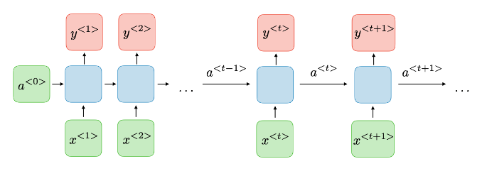
RNN model
Recurrent Neural Network include a cycle or feedback loop in the network connections.
Information is propagated from one step to consequential step.
That is suitable with the sequential problem such as: machine learning translation, time series forecast.
https://stanford.edu/~shervine/teaching/cs-230/cheatsheet-recurrent-neural-networks

Slide 11
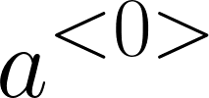


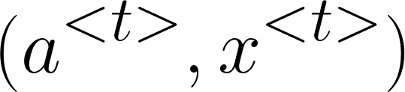
RNN model
Init hidden state:
Each time model return a hidden state
This hidden state encodes the previous context and feeds into the next step.
Embedding each word at step t as a vector and feeds into the next step.
forward into next step (t+1).
https://stanford.edu/~shervine/teaching/cs-230/cheatsheet-recurrent-neural-networks

Slide 12
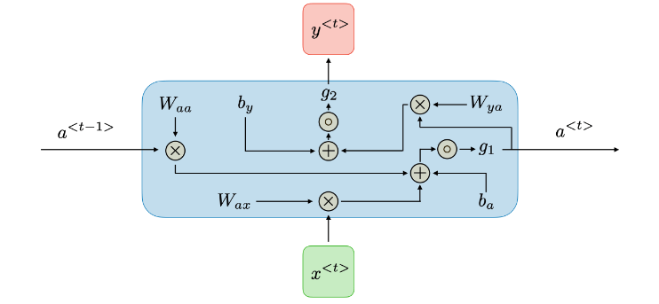



RNN model - RNN cell
Activation value at t timestep:
Predict value timestep:
Shared coefficients:
https://stanford.edu/~shervine/teaching/cs-230/cheatsheet-recurrent-neural-networks

Slide 13
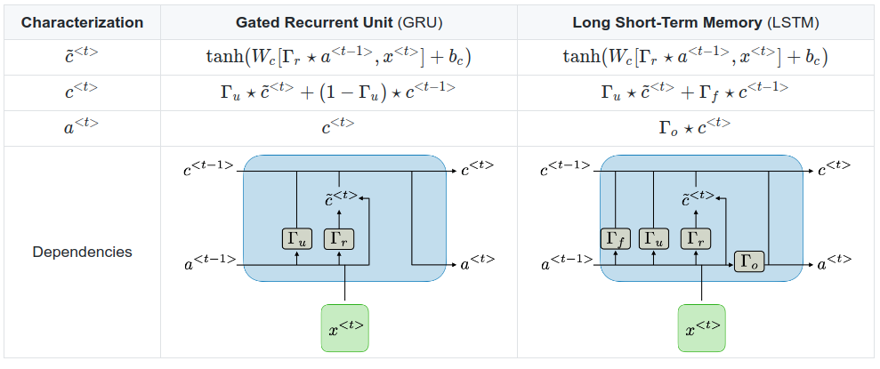
RNN model - LSTM/GRU
Types of gates in LSTM/GRU
https://stanford.edu/~shervine/teaching/cs-230/cheatsheet-recurrent-neural-networks

Slide 14
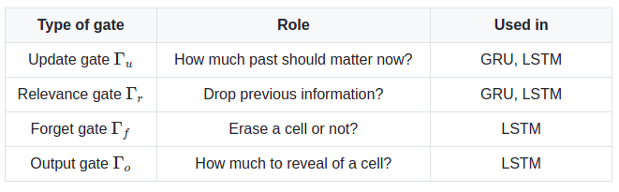
RNN model - LSTM/GRU
Types of gates in LSTM/GRU
https://stanford.edu/~shervine/teaching/cs-230/cheatsheet-recurrent-neural-networks

Slide 15
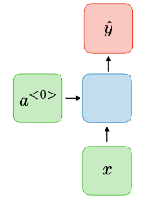
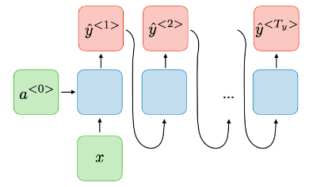
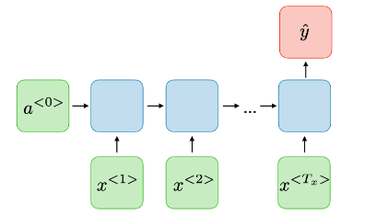
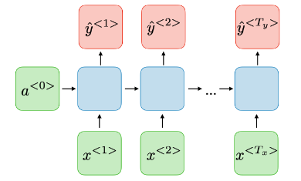
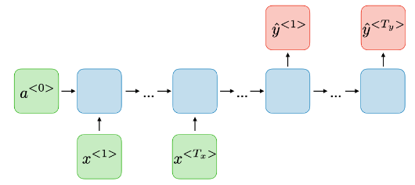
RNN model - Applications
one-to-one
one-to-many
many-to-one
many-to-many (Tx == Ty)
many-to-many (Tx >< Ty)
https://stanford.edu/~shervine/teaching/cs-230/cheatsheet-recurrent-neural-networks

Slide 16
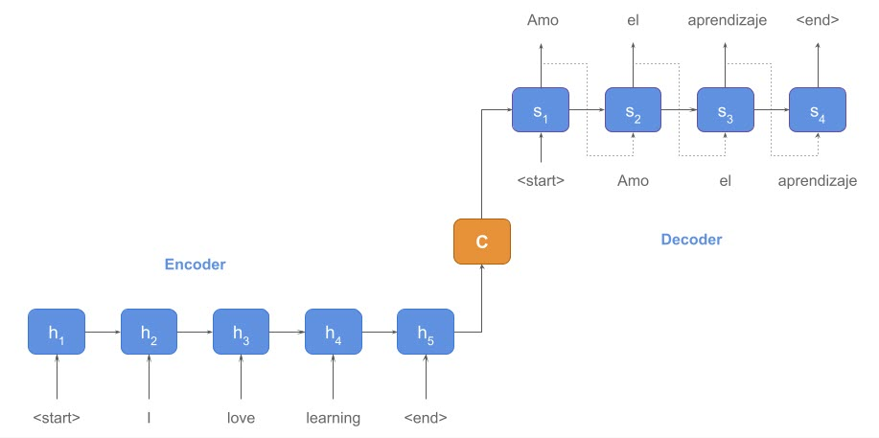
Encoder - Decoder
Encoder:
Converts an input sequence of tokens into a sequence of embedding vectors, often called the hidden state or context.
Decoder:
Uses the encoder’s hidden state to iteratively generate an output sequence of tokens, one token at a time.

Slide 17
Encoder - Decoder
Encoder:
Converts an input sequence of tokens into a sequence of embedding vectors, often called the hidden state or context.
Last hidden state: Including the whole context of previous word
Decoder:
Uses the encoder’s hidden state to iteratively generate an output sequence of tokens, one token at a time.

Slide 18
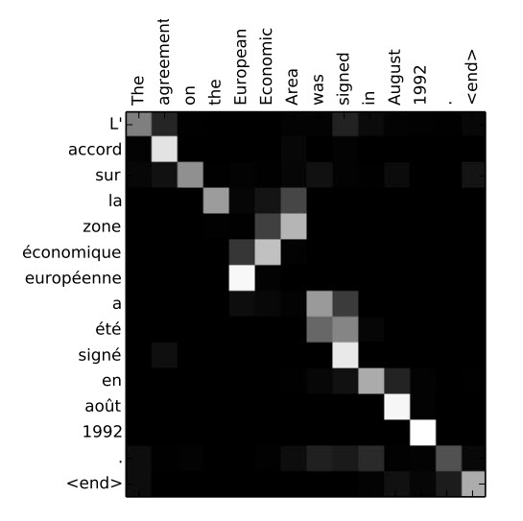





Attention mechanism
Decoder
pay attention to each word in the sequence.
context vector capture meaning of the whole sequence.
Context vector

Slide 19
Shortcoming of Sequential
Requires to process prediction in sequence.
Study in uni-directional.
Cannot capture the long dependency.
The vector representation for each word is unique and do not depend on context.

Slide 20
Transformer advantage
Study the word in bidirectional (BERT is Bidirectional Encoder Representation from Transformer)
Well capture the long dependency and learn the context well
The representation of word changes according to the context
Can create stack layers which are deeper
Transfer learning become easier.

Slide 21
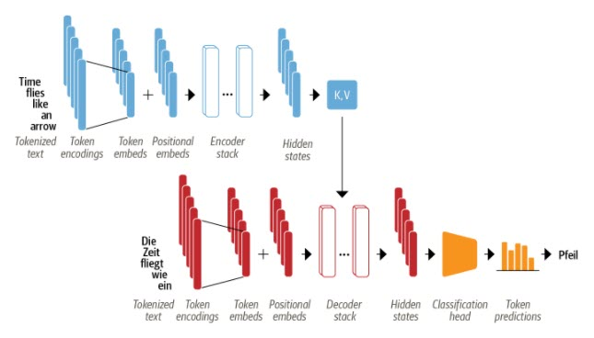
Transformer architecture -Encoder Decoder
Encoder
Decoder
Transformer architecture was originally designed for sequence2sequence task in NLP like machine learning translation. That include two parts:
Encoder: Finding the Key and Value embedding vectors. The encoder’s output is fed to each decoder layer.
Decoder: Generating a prediction for next token in the sequence.

Slide 22
Transformer architecture - Overview
Encoder only: Finding numerical representation that is well suited for tasks like text classification or named entity recognition. For example: BERT, RoBERTa and DistilBERT
Decoder only: Suited for auto-complete the sequence. For example: GPT
Encoder - Decoder: Suitable for machine translation and summarization. For example: The Transformer, BART and T5 models.
Encoder-Decoder
Encoder only
Decoder only

Slide 23
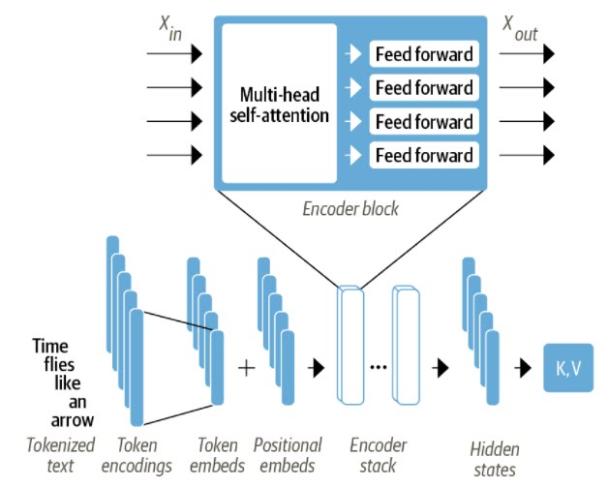
Transformer architecture - Encoder
(batch_size, seq_length, hidden_size)
(batch_size, seq_length, hidden_size)
A deep stack of blocks includes both skip connection and batch normalization as the other deepth CNN architecture.
Architecture include two components:
Multi-head attention: Update the representation of the inputs based on the self-attention
Feed forward layer: Project into new feature space by fully connected layers.

Slide 24
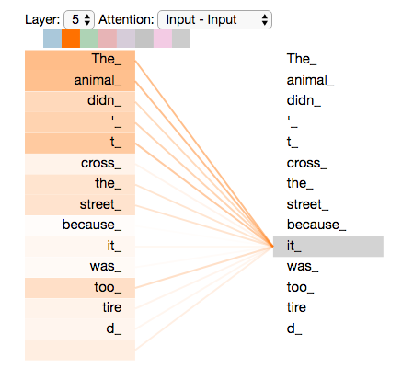
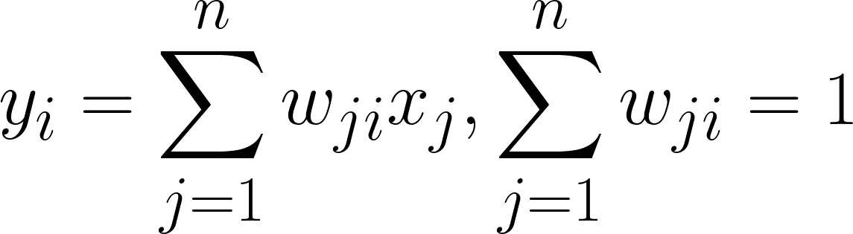
Transformer architecture - Self Attention
Allow the network to pay attention are different to each part of sequence.
Using attention to make weighted average of the whole sequence embedding
Self - attention bakes the understanding of relevant words into the one currently processing.
https://jalammar.github.io/illustrated-transformer/

Slide 25
Transformer architecture - Self Attention
Allow the network to pay attention are different to each part of sequence.
Using attention to make weighted average of the whole sequence embedding
Self - attention bakes the understanding of relevant words into the one currently processing.
Why this representation is a good idea?
https://jalammar.github.io/illustrated-transformer/

Slide 26
Transformer architecture - Self Attention
Allow the network to pay attention are different to each part of sequence.
Using attention to make weighted average of the whole sequence embedding
Self - attention bakes the understanding of relevant words into the one currently processing.
Why this representation is a good idea?
Contextualize embedding
Assign the relevant words a higher importance
Word representation change according to context
https://jalammar.github.io/illustrated-transformer/

Slide 27
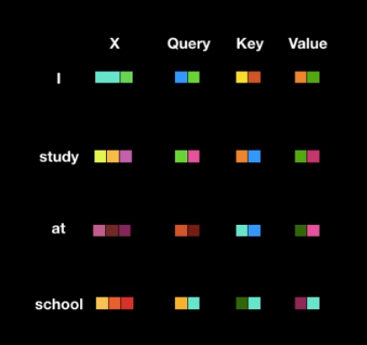
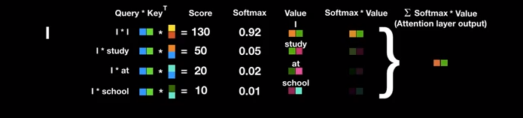
Self Attention process
Scaled Dot-Product Attention
Create key, query,
value vector
Compute Attention
Score
Compute Attention
Weight
Update Embedding
Token
Scaled dot-product attention practice

Slide 28
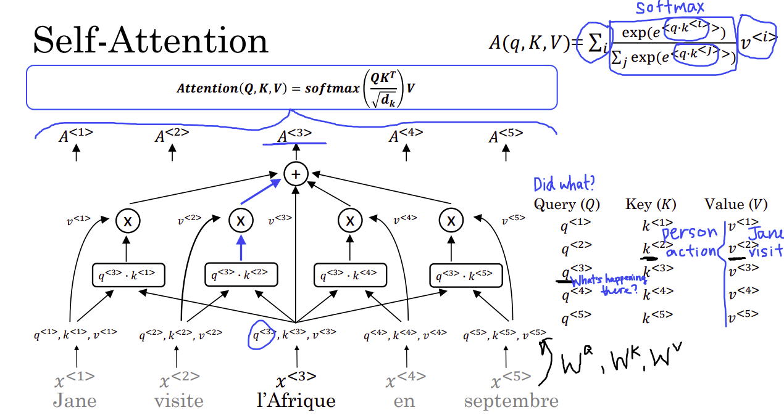
Self Attention process
Scaled Dot-Product Attention

Slide 29
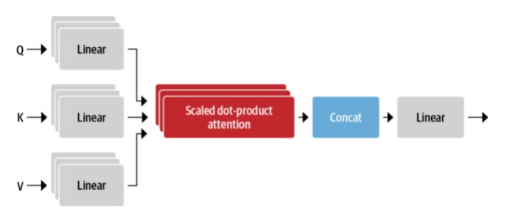
Self Attention - Time to prace
Multi-head Attention
Model carry out multiple linear projection independently.
It seems beneficial for model learnable ability.
Scaled dot-product attention practice

Slide 30
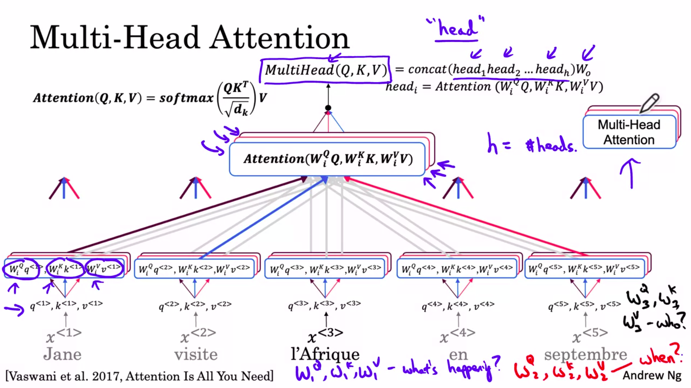
Self Attention - Time to prace
Multi-head Attention
Scaled dot-product attention practice

Slide 31
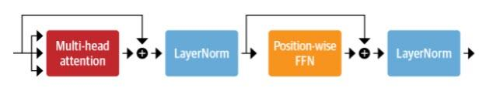
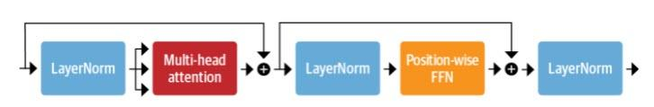
Transformer - a SubLayer
Post - layer norm
Preprocess- layer norm
Apply Layer norm to get faster convergence
Skip connection also added like in deep CNN.
Scaled dot-product attention practice

Slide 32
Transformer Encoder - Positional Embedding
Sub Layers
Encoder
+
Embedding of input
Positional Embedding
Input sequence
Positional Embedding is a good way to inject position information into model studying.
Normally we use statistic embedding under sin and cosine formulation..
Scaled dot-product attention practice

Slide 33
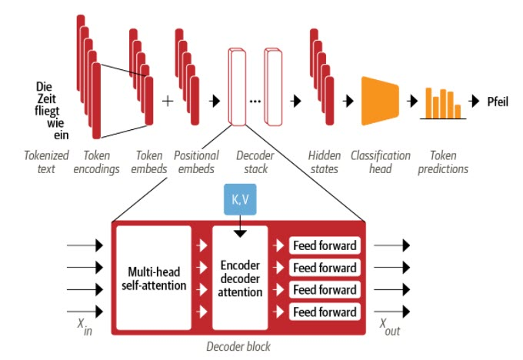
Transformer architecture - Decoder
Multi-head Attention
Basically the same as Encoder but use key and value vectors from encoder as input.
Applies masked matrix to prevent the future words can affect to current word prediction.
Scaled dot-product attention practice

Slide 34
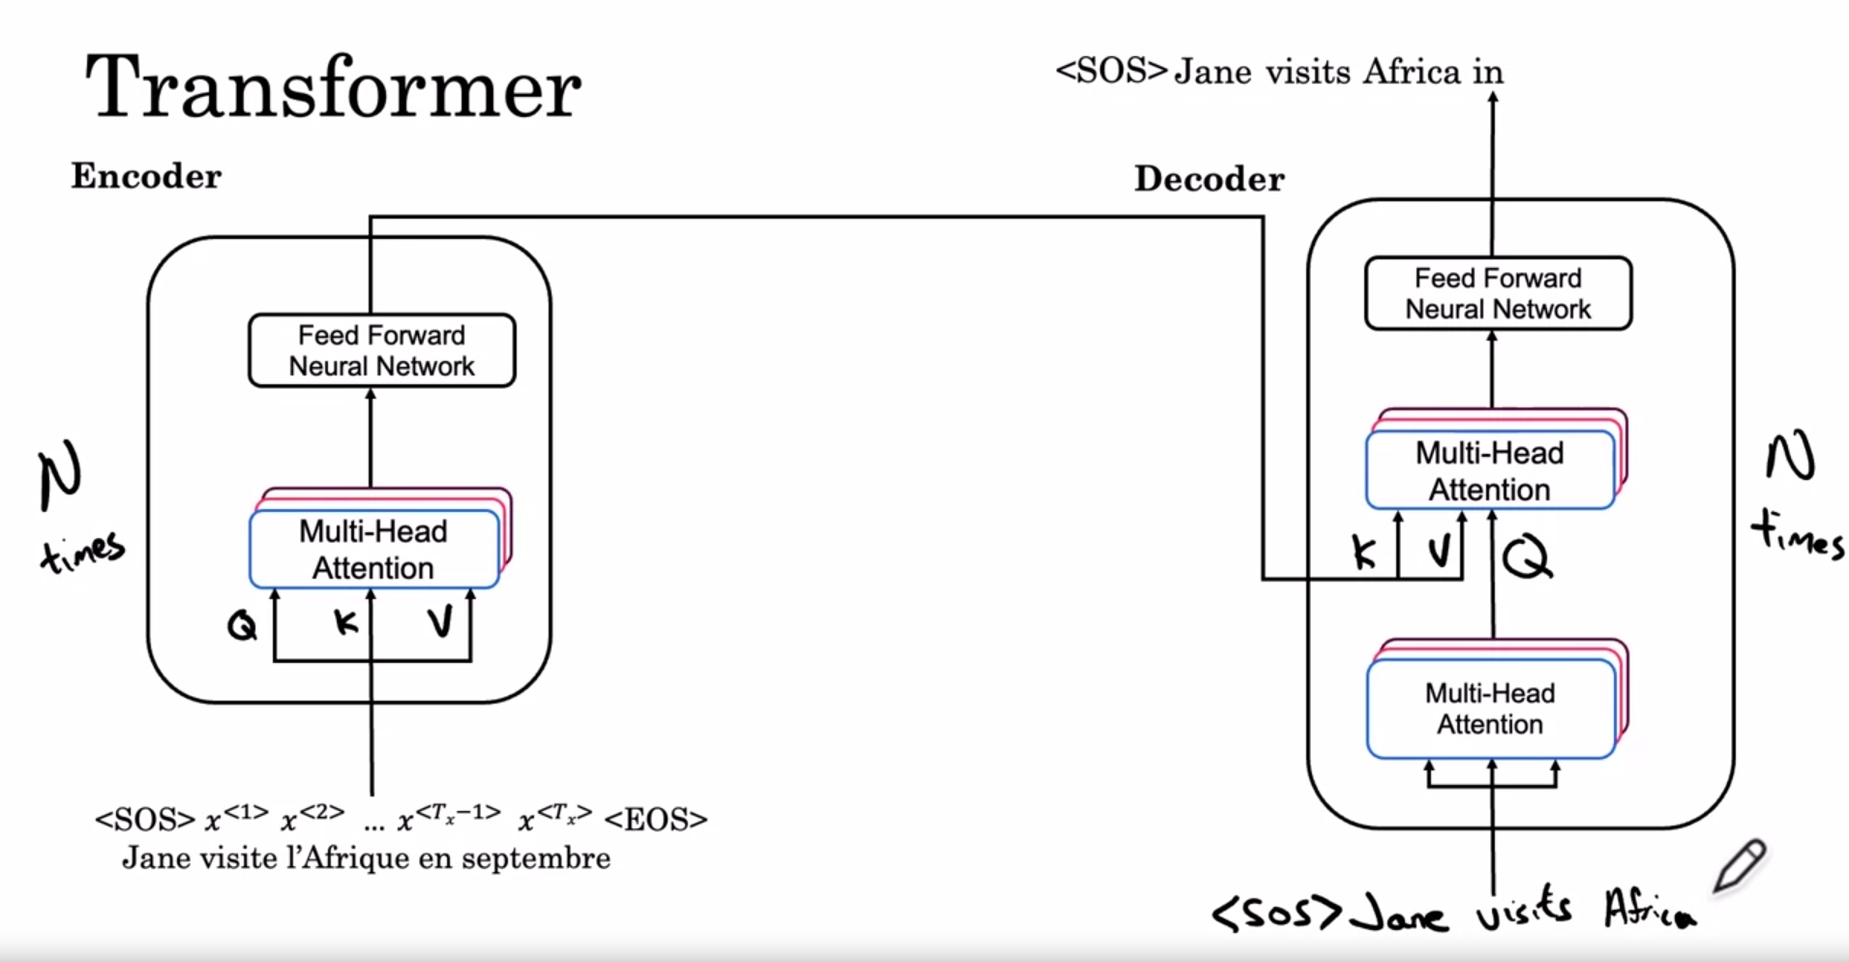
Transformer architecture
Scaled dot-product attention practice

Slide 35
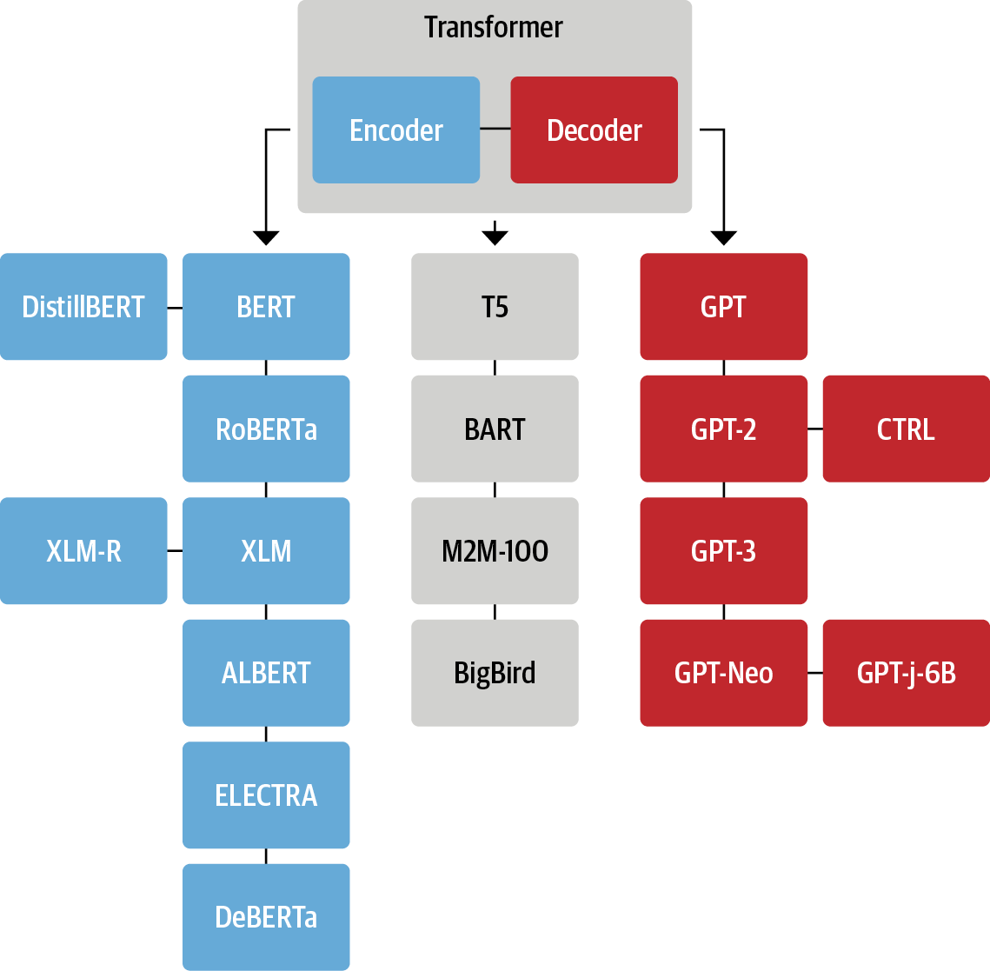
Transformer Tree of Life
https://www.facebook.com/TowardDataScience/posts/4553647941337173

Slide 36
Create your own machine learning
translation model
https://www.facebook.com/TowardDataScience/posts/4553647941337173

Slide 37
Thanks your!

